Slide 1



Data Collection Project Presentation
By: Hariz, Varun and Jee Chee

Slide 2

SURVEY OBJECTIVE
" To identify and compare the capacity of University of Canterbury library a week before and a week during semester break with respect to the busy and non-busy periods.
Here, busy period is defined as time period which ranged between 11 to 3 pm and non-busy period was the one excluding this time interval."

Slide 3



Sampling Method
Simple Random Sampling (SRS)
Allocation of work
Hours per person

Slide 4
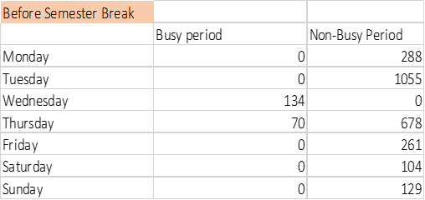
Data Quality & Analysis
Summary Statistics | Busy Period |  | Non-Busy Period
- | Before Semester Break | During Semester Break | Before Semester Break | During Semester Break
Mean | 29 | 78 | 359 | 51
Median | 0 | 58 | 261 | 50
Max | 134 | 180 | 1055 | 90
Min | 0 | 0 | 0 | 0
Highest mean – Busy period during semester break
Lowest mean – Busy period before semester break
Minimum value is 0 across all periods
Maximum value is 1055 (non-busy period before semester break)
Missing Data – Null value is replaced by 0 for data cleaning and visualization purposes

Slide 5
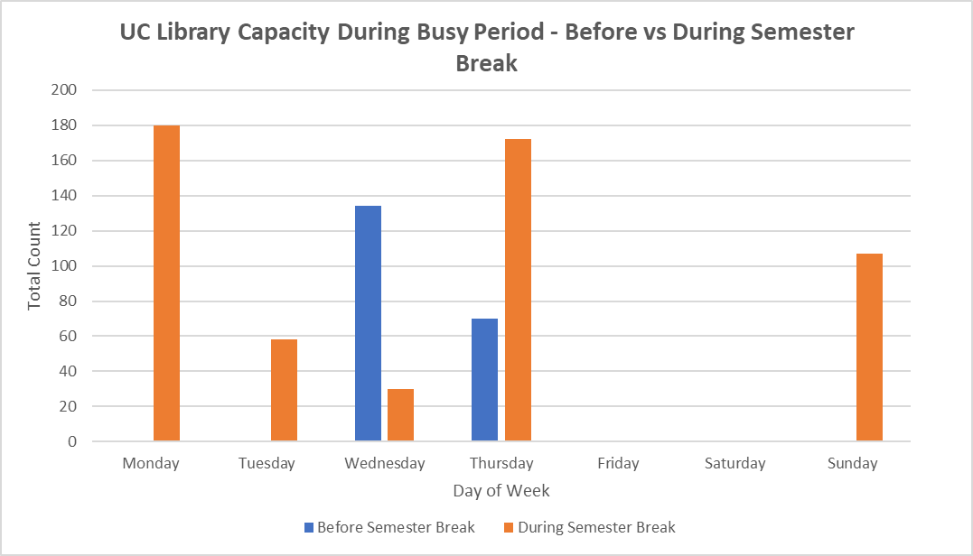
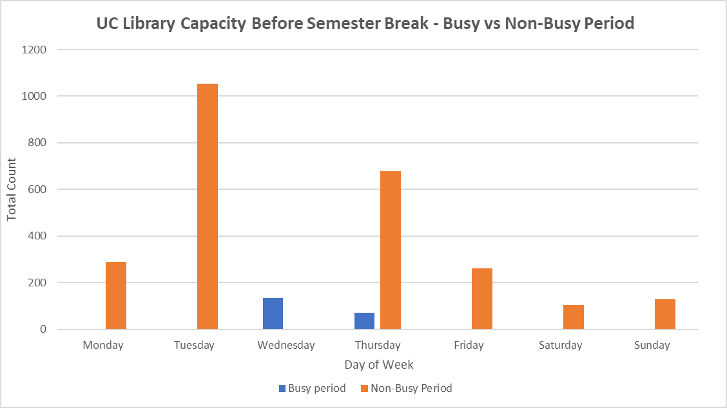
Data Quality & Analysis
There is data present only on Wednesday and Thursday during busy period before semester break
Graph suggests that busy period during semester break is generally busier that before semester break. But is that true?
Imbalance of data recorded between busy and non-busy period before semester semester break

Slide 6


Observation
Inconsistency of data
Bias
Environment pressure

Slide 7
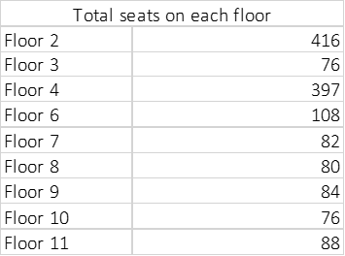
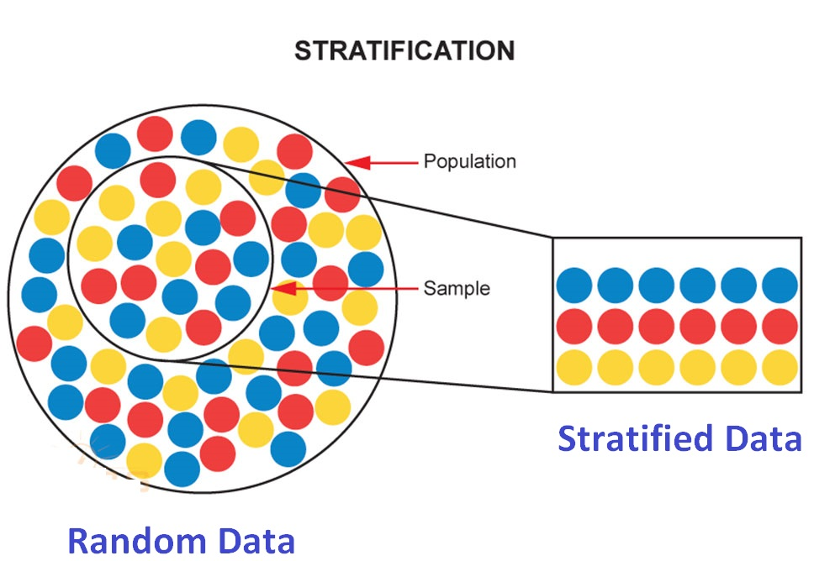
Improvement
Population Variability
More allocation of people
Different sampling method – Stratified Sampling
Sampling Method (Stratification):
Divide population into 2 Strata
Homogeneity within each stratum, hence, within-strata variance will be lesser

Slide 8


Conclusion

Slide 9
Q & A

